Slide 1
2023 Travelers Analytics Case Competition
InsNova Auto Insurance Company Modeling Problem

Slide 2
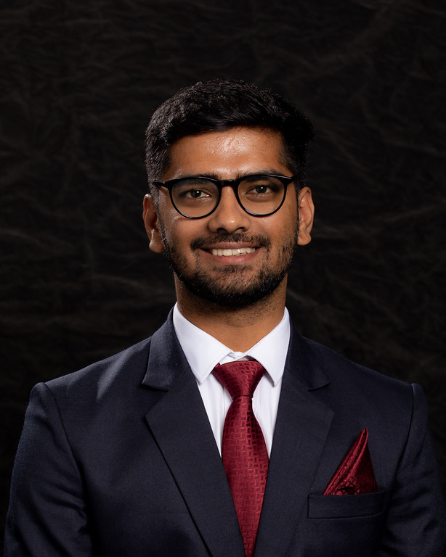
Manas Joshi
Degree: Masters in Business Analytics and Project Management, May 2024
University: University of Connecticut
Team: Data Modeler
Aspirations:
Data Driven Excellence
Leadership and Development

Slide 3
Business Problem and Objective
Business Problem – Addressing Competitive Challenges in InsNova Auto Insurance Through Enhanced Claim Prediction and Statistics
Objective - Developing a Robust Predictive Model for Auto Insurance Claim Costs
1. Enhance Pricing Accuracy
2. Improve Risk Segmentation
3. Stay Competitive in the Market

Slide 4
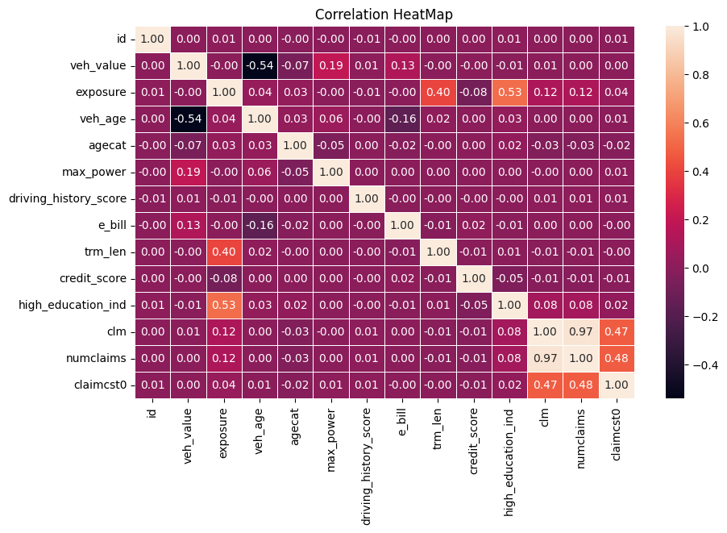
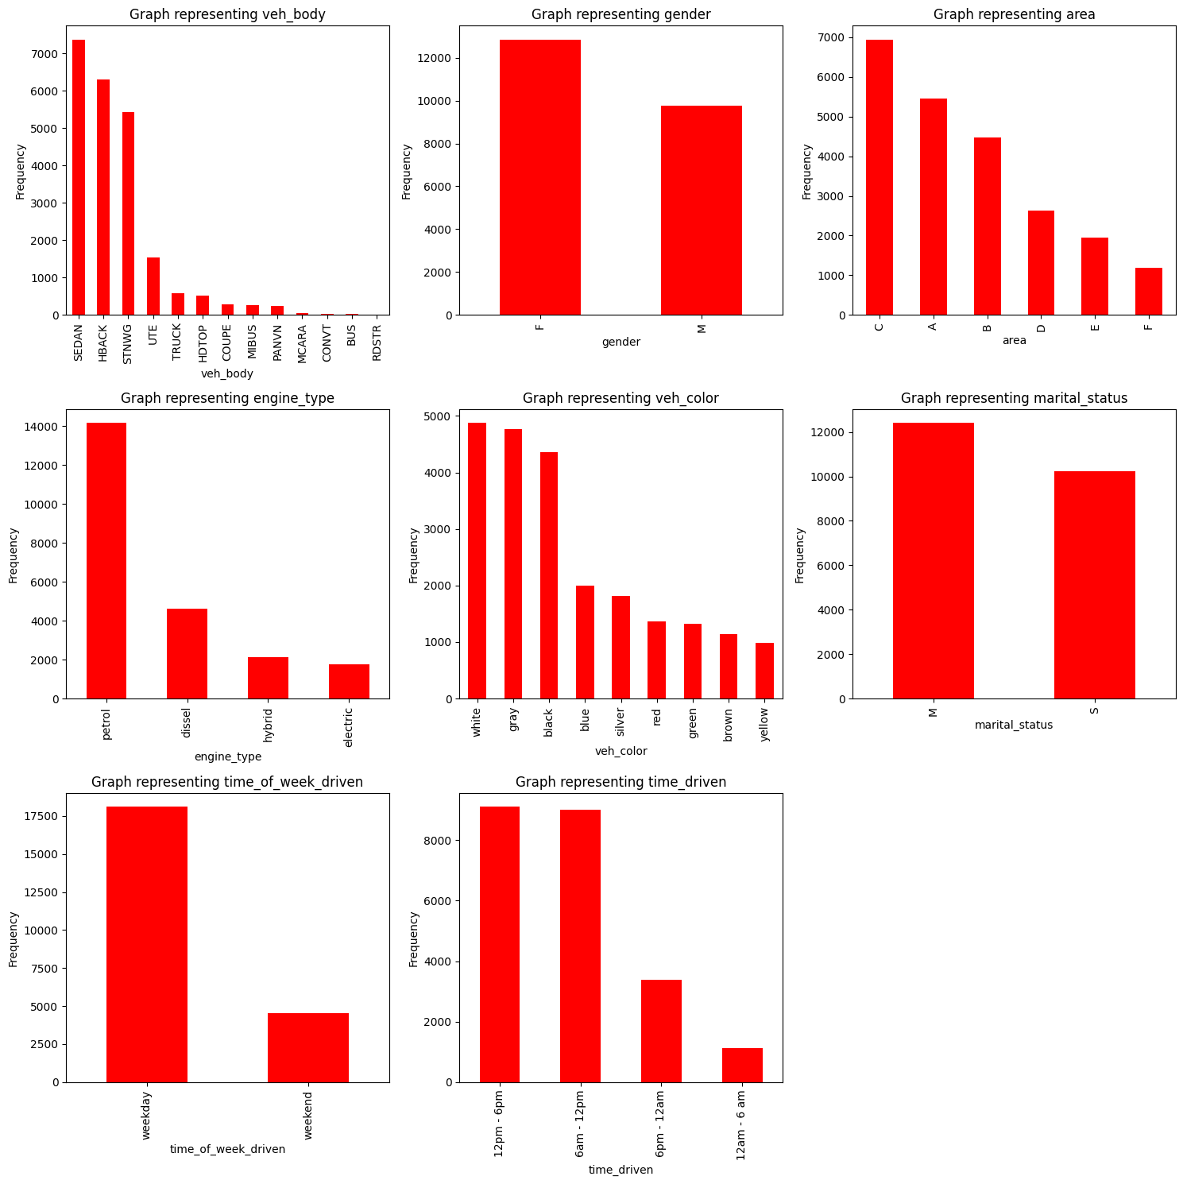
Data Collection and Sources
Training Data consists of 22619 rows and 22 columns in which 8 columns are categorical and rest are numerical
Test Data consists of 22620 rows and 19 columns
Notes:
Link to the Data - https://www.kaggle.com/competitions/2023-travelers-university-competition/data

Slide 5
Data Preprocessing and Transformation
Descriptive Statistics(Mean, Mode, Median, Variance, SD, IQR)
Dealt with Missing Values, Outliers, and Duplicate Data
Transformed Categories to Numbers using Label Encoder
Standardized Data Range with Power Transformer

Slide 6
Feature Engineering and Selection
Used Algorithm such as SelectKBest and Permutation Importance for Feature Selection
Exposure, Age-Category, Term Length, Time of Week Driven, Driving History Score, Engine Type, Time Driven, Gender, and Marital Status are the variables which explain pure premium
Variable such as Vehicle-Company, Geographical Location, Type of Claim, Vehicle-Insurance, and Annual-mileage could be useful for predicting claim-cost

Slide 7
Model Development and Selection
Evaluated Linear Regression achieving an MSE of 1,630,785.13 and an R² of 0.002; also assessed regularized regressions—Elastic Net, Ridge, and Lasso—for better prediction accuracy
Investigated complex models including Decision Trees, Random Forest, SVM, Gradient Boosting, LightGBM, and CatBoost for their advanced pattern recognition potential
One concern is that linear regression assumes a linear relationship between predictors and outcome, which may not capture complex patterns. Also, it can be sensitive to outliers, which I have mitigated through robust preprocessing

Slide 8
Results and Business Impact
Considered several regression models. My focus on the model which could provide both accuracy and interpretability.
Linear regression was chosen due to its strong performance on preliminary tests, its ability to provide interpretable results, and its simplicity, which aids in understanding variable impact on pure premium.
The model was evaluated using R-squared and MSE. Cross-validation was employed to mitigate overfitting and ensure that the model generalized well to unseen data.
I am curious about the extent of the data's coverage, such as whether it fully captures the diversity of drivers and vehicles insured, and how comprehensively claims are reported and recorded.

Slide 9

Questions?

Slide 10
Appendix
Link to the Data(Kaggle) - https://www.kaggle.com/competitions/2023-travelers-university-competition/data
Link to Colab - https://colab.research.google.com/drive/1I55G1Ngij0hSq_heThEBRMdqVzO8DYN5?usp=sharing

